Slide 1
Introduction to Big Data
Joy Chakraborty
20th & 21st March, 2014

Slide 2
Agenda
Why Big Data?
Big Data Architecture
AGT’s Big Data Architecture
Introducing Hadoop
HDFS
MapReduce
Others
Cloudera’s Hadoop Distribution
Conclusion

Slide 3
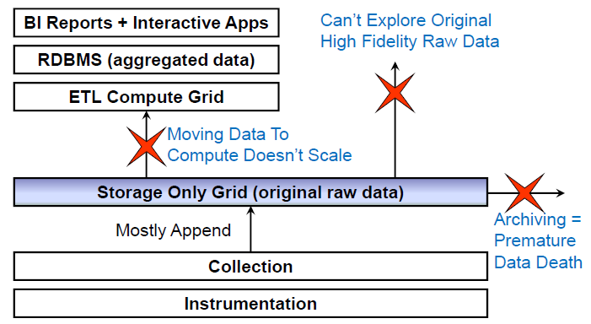
Limitation of Existing Data Architecture – E.g. Analytics

Slide 4
What is Big Data?
There’s no one definition for ‘big data’
it’s a very subjective term. Most people would consider a data set of terabytes or more to be ‘big data’
but there are certainly people using Hadoop with great success on smaller chunks of data than that.
One reasonable definition is that it’s data which can’t comfortably be processed on a single machine.
A potential challenge with big data is –
that it is created very fast and does come from different sources which could come in a variety of formats.
In my experience, most data is not worthless but actually does have a lot of value.

Slide 5
The 3 V’s of Big Data
Volume refers to the size of data that you’re dealing with
Variety refers to the fact that the data is often coming from lots of different sources and in many different formats
Velocity refers to the speed at which the data is being generated, and the speed at which it needs to be made available for processing

Slide 6
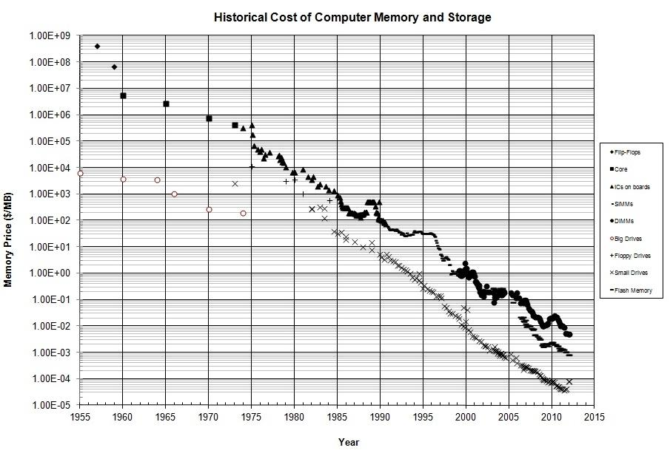
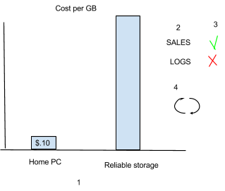
Big Data - Volume
SAN is expensive reliable storage – puts cap on amount usage
Reading, processing and streaming data from SAN is slow

Slide 7
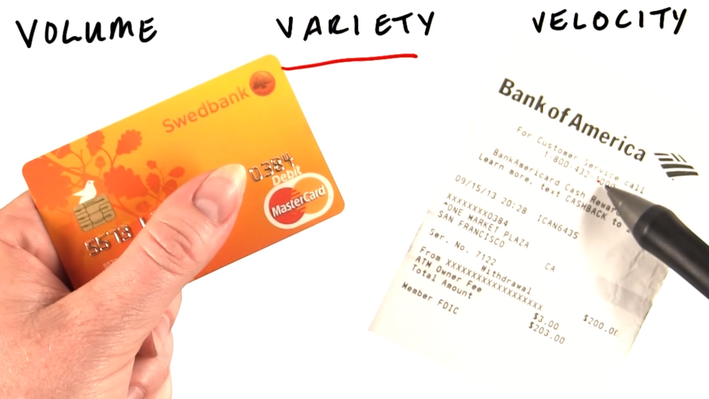
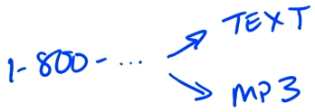
Big Data - Variety
RDMS provides limits on unstructured data
How about new format that is not in plan right now?
Storing data in its original format and process the data later in different ways you might not even have thought of originally
Notes:
Software to analyze Tone of voice

Slide 8
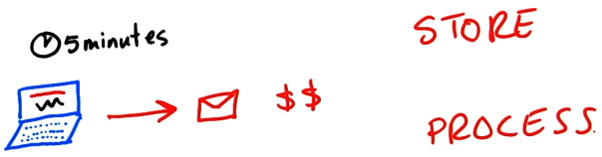
Big Data - Velocity
we can’t store it as it arrives, we’ll end up discarding some of it that can be important latter
Normally store the purchased and saved data but not the browsing data.
How about storing and processing all data?

Slide 9
Requirements
Problems need to be solved
Store massive amounts of data in a cost-effective way
Process the data efficiently and fast
Constraints
Limited storage capability per machine
Limited processing capability per machine

Slide 10
How about non Big-Data? Because every data problem is not a big data problem.
Solving Big Data along with non Big Data
Common Architecture

Slide 11

Reference Architecture
Software: Your choice of best-of-bred & open-source
Analytics Software Environment
USH, ReadMind, Others …
Resource sharing / multi-tenancy
Platform Symphony Advanced Edition
(optional)
Scheduler
Hadoop Scheduler /
Platform Symphony Scheduler (included)
GPFS FPO
Connector
Distributed File system
HDFS
GPFS 3.5.0.9
(optional)
Operating system
Windows, Linux, RHEL, etc.
Provisioning and
Cluster Management
Platform Cluster Manager
Platform Cluster Manager – AE
(optional)
2 x Mellanox ConnectX data network
1 x dual-port 1 GbE management network
Network
Hardware
x3550 M4 master node(s)
X3630 M4 compute nodes
Optional components

Slide 12







Big Data Platform
A Comprehensive solution for Big Data Analytics
Analytic Applications
Comprehensive platform
Data at rest, data in motion
Structured, un-structured, semi-structured
Extensive library of data connectors
Rich development tools
Application accelerators
Web-based management console
BI / Reporting
Exploration / Visualization
Functional App
Industry App
Predictive Analytics
Content Analytics
Big Data Platform
Visualization & Discovery
Application Development
Systems Management
Accelerators
Hadoop System
Stream Computing
Data Warehouse
Information Integration & Governance
Agile, multi-tenant shared infrastructure

Slide 13
Example of Big-Data Platform
Visualization & Discovery
Applications & Development
Administration
Integration
BigSheets
Apps
Text Analytics
MapReduce
Admin Console
JDBC
Dashboard & Visualization
Workflow
Pig & Jaql
Hive
Monitoring
::::
Advanced Analytic Engines
Adaptive Algorithms
Text Processing Engine & Extractor Library)
R
postgresql
Workload Optimization
Streams
Integrated Installer
Enhanced Security
Splittable Text Compression
Adaptive MapReduce
DataStage
ZooKeeper
Oozie
Jaql
Flexible Scheduler
HCatalog
::::
Lucene
Pig
Hive
Index
Platform Computing
Runtime / Scheduler
MapReduce
Symphony
Symphony AE
Management
Security
Cognos
Data Store
HBase
Audit & History
Flume
Lineage
File System
HDFS
GPFS FPO
Sqoop
Open Source
IBM
Optional

Slide 14
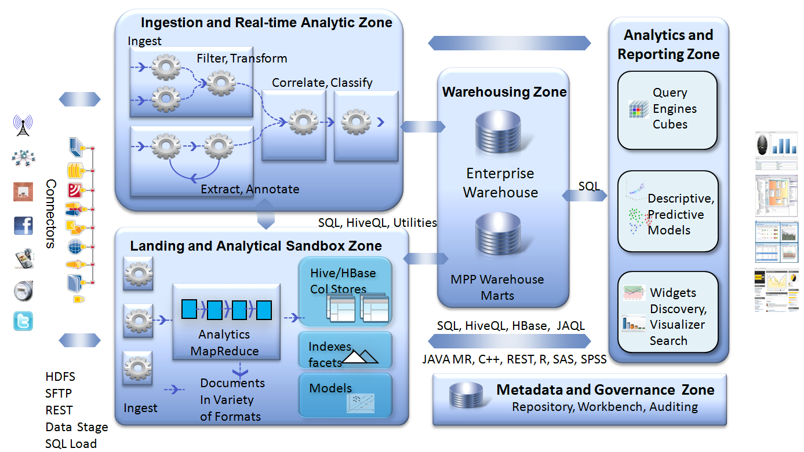
Complexity: A Key Customer Challenge
Multiple distributed software components, often deployed on separate infrastructure
expensive to deploy, expensive to manage, expensive to evolve

Slide 15
AGT’s Data processing Platform - Architectural Requirements
Flexibility
Adding new clusters and modules such as analytics modules easily (e.g. using tooling)
Changing data flow within data processing platform (between clusters) through configuration
Should support processing and storage of Big-Data (Volume, Variety & Velocity) + Data not classified as Big-data
Independent Evolvement and scalability
Data Processing and storage infrastructure should evolve and scale independently
Sharing and abstracting Data storage Infrastructure
Shared data storage to reduce latency and avoid data duplication
Abstracting data storage infrastructure from data producer/consumer and accessing data through respective technology dependent APIs with standard interfaces.
Supporting multiple data storage technologies within data storage infrastructure based on needs.
Supporting Cloud Infrastructure
On demand processing resource allocation based on need/load
Supporting Monitoring and runtime configuration of data processing infrastructure
Adding/configuring new data processing cluster flexibly with necessary tooling
Support for on-demand provisioning/de-provisioning cluster(s)
Tooling support in capturing non functional operational data and statistics such as performance counters.
Compos-ability
Allowing to compose multiple modules (e.g. analytics modules) flexibly (e.g. though configuration and tooling) using workflow mechanism in support of business use-case needs.
Support of Hierarchical grouping of modules in support of business use-case needs using workflow

Slide 16
AGT Big-Data Architecture (Component View)
Communication Infrastructure Layer (E.g. Pub-Sub, Service Bus, ESB)
:::
Data Processing Platform
ReadyMind, USH
Shared Data Storage Platform

Slide 17
AGT Big-Data Architecture (Component View)
Communication Infrastructure Layer (E.g. Pub-Sub, Service Bus, ESB)
BBig
:::
Data Processing Platform
Respective Interfaces
Management and Administrative components
ReadyMind, USH
Data Clusters (Big-Data + non Big Data)
Shared Data Storage Platform

Slide 18
AGT Big-Data Architecture (Component View)
Communication Infrastructure Layer (E.g. Pub-Sub, Service Bus, ESB)
BBig
:::
Data Processing Platform
Respective Interfaces
Analytics Modules
Configuration
Monitoring
Provisioning
Command Processor
Administration
ReadyMind, USH
Workflow Mgmt.
Hosting
Security
Kafka Cluster
Hadoop Cluster
Storm Cluster
Other Clusters
:::
Other Clusters
Data Clusters
Shared Data Storage Platform

Slide 19
AGT Big-Data Architecture (Component View)
Communication Infrastructure Layer (E.g. Pub-Sub, Service Bus, ESB)
BBig
:::
Data Processing Platform
Respective Interfaces
Analytics Modules
Configuration
Monitoring
Provisioning
Command Processor
Administration
ReadyMind, USH
Workflow Mgmt.
Hosting
Security
Kafka Cluster
Hadoop Cluster
Storm Cluster
Other Clusters
:::
Other Clusters
Big Data Clusters
Storage related Interfaces
Redis
No-SQL Storage
Other Storages
SQL Server
Other relational Data Storage
Other Storages
Big-Data/High-Perf Data Storage (e.g. HDFS)
Relational Data Storage
Shared Data Storage Platform

Slide 20
Analytics Platform Architecture (Component View)
Communication Infrastructure Layer (E.g. Pub-Sub, Service Bus, ESB)
BBig
:::
Data Processing Platform
Respective Interfaces
Analytics Modules
Configuration
Monitoring
Provisioning
Command Processor
Administration
ReadyMind, USH
Workflow Mgmt.
Hosting
Security
Big-Data
Non Big-Data
GPU Cluster
:::
Processing Clusters
Storage related Interfaces
Redis
No-SQL Storage
Other Storages
SQL Server
Other relational Data Storage
Other Storages
Big-Data/High-Perf Data Storage (e.g. HDFS)
Relational Data Storage
Shared Data Storage Platform

Slide 21
AGT Cloud Architecture (Component View)
Cloud Platform

Slide 22
AGT Cloud Architecture (Component View)
Cloud Platform
Communication Platform
Processing Platform
Processing Platform
Storage Platform

Slide 23
AGT Cloud Platform Architecture (Component View)
Communication Infrastructure Layer (E.g. Pub-Sub, Service Bus, ESB)
BBig
Processing Platform
:::
Respective Interfaces
Analytics Modules
Configuration
Monitoring
Provisioning
Command Processor
Administration
ReadyMind, USH
Workflow Mgmt.
Hosting
Analytics Processing Clusters
Security
:::
Storage related Interfaces
Redis
No-SQL Storage
Other Storages
SQL Server
Other relational Data Storage
Other Storages
Big-Data/High-Perf Data Storage (e.g. HDFS)
Relational Data Storage
Shared Data Storage Platform

Slide 24
AGT Cloud Enabled Analytics Platform Architecture (Component View)
Communication Infrastructure Layer (E.g. Pub-Sub, Service Bus, ESB)
BBig
Data Processing Platform
:::
Respective Interfaces
Analytics Modules
Configuration
Monitoring
Provisioning
Command Processor
Administration
ReadyMind, USH
Workflow Mgmt.
Hosting
Security
Big-Data
Non Big-Data
GPU Cluster
Other Processing Clusters
:::
Data Processing Clusters
Storage related Interfaces
Redis
No-SQL Storage
Other Storages
SQL Server
Other relational Data Storage
Other Storages
Big-Data/High-Perf Data Storage (e.g. HDFS)
Relational Data Storage
Shared Data Storage Platform

Slide 25

What is Apache Hadoop?
A scalable fault-tolerant distributed system for data storage and processing (open source under the Apache license).
Core Hadoop has two main systems:
Hadoop Distributed File System: self-healing high-bandwidth clustered storage.
MapReduce: distributed fault-tolerant resource management and scheduling coupled with a scalable data programming abstraction.

Slide 26
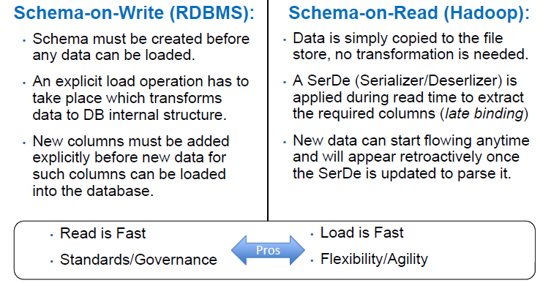
The Key Benefit: Agility/Flexibility

Slide 27
Flexibility: Complex Data Processing
Java MapReduce: Most flexibility and performance, but tedious development cycle (the assembly language of Hadoop).
Streaming MapReduce (aka Pipes): Allows you to develop in any programming language of your choice, but slightly lower performance and less flexibility than native Java MapReduce.
Crunch: A library for multi-stage MapReduce pipelines in Java (modeled After Google’s FlumeJava)
Pig Latin: A high-level language out of Yahoo, suitable for batch data flow workloads.
Hive: A SQL interpreter out of Facebook, also includes a metastore mapping files to their schemas and associated SerDes.
Oozie: A PDL XML workflow engine that enables creating a workflow of jobs composed of any of the above.

Slide 28
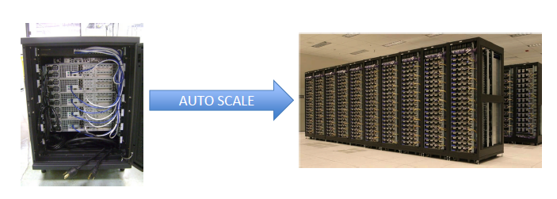
Scalability: Scalable Software Development
Grows without requiring developers to re-architect their algorithms/application

Slide 29
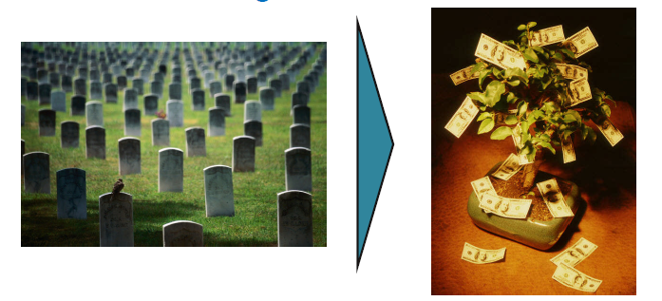
Scalability: Keep All Data Alive Forever
Archive to Tape & Never See Again
Extract Value from Your Data

Slide 30
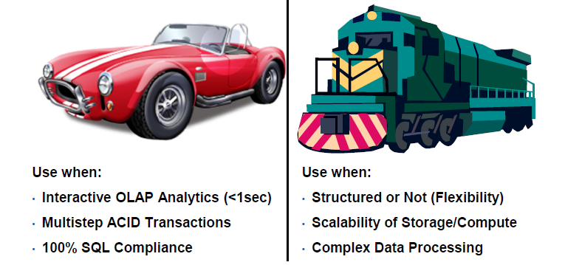
Use The Right Tool For the Right Job
Relational Database:
Hadoop:

Slide 31
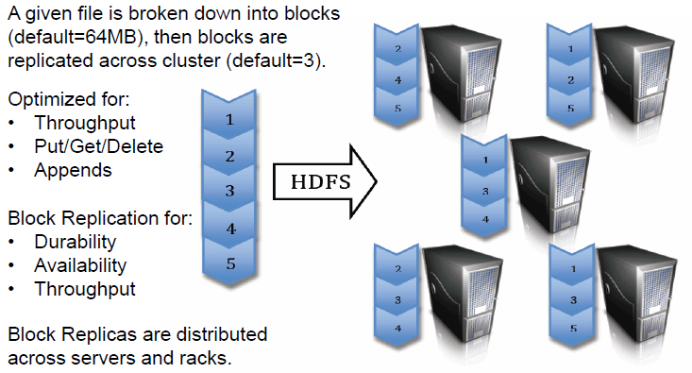
HDFS: Hadoop Distributed File System

Slide 32
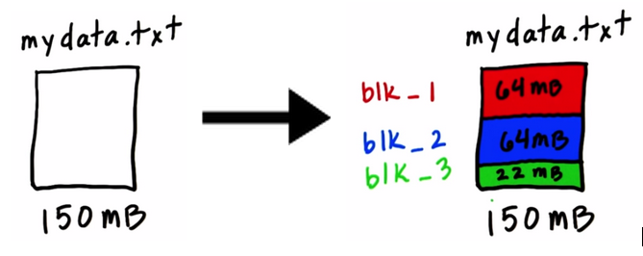
HDFS: Hadoop Distributed File System

Slide 33
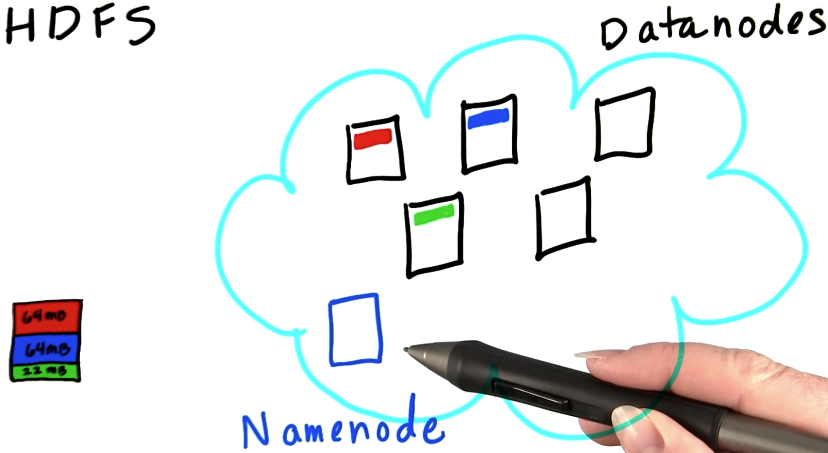
HDFS: Hadoop Distributed File System
There’s a daemon, or piece of software, running on each of these cluster nodes called the DataNode, which takes care of storing the blocks.
Now, clearly we need to know which blocks make up the file. That’s handled by a separate machine, running a daemon called the NameNode. The information stored on the NameNode is known as the ‘metadata’.
Notes:
Daemon -> Data Node and Name Node

Slide 34
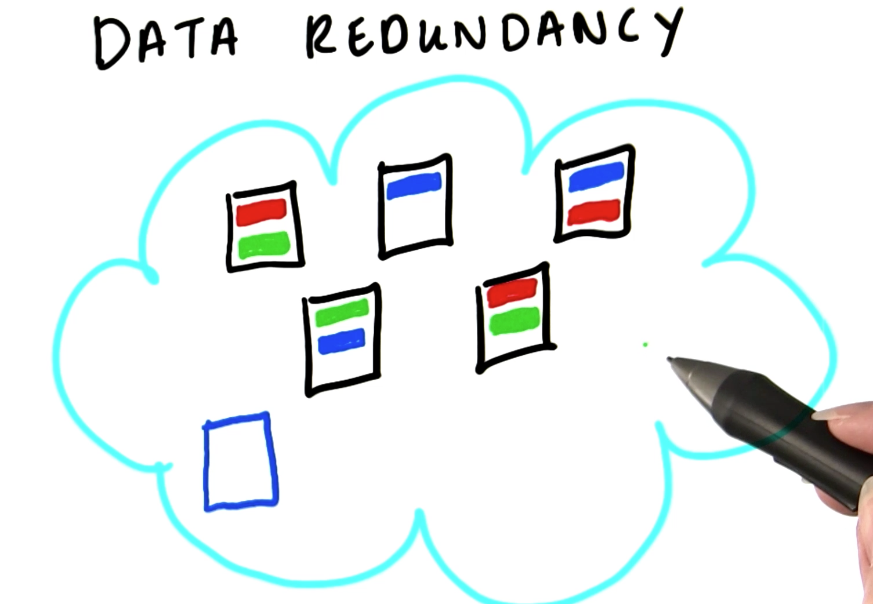
HDFS: Data Redundancy
Hadoop replicates each block three times as it’s stored in HDFS
Hadoop just picks three random nodes, and puts one copy of the block on each of the three
if a single node fails, it’s not a problem because we have two other copies of the block on other nodes. And the NameNode is smart enough that if it sees that any of the blocks are under-replicated, it will arrange to have those blocks re-replicated on the cluster so we’re back to having three copies of them again

Slide 35
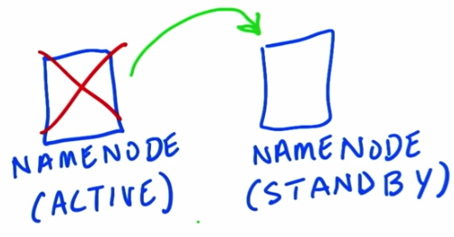
HDFS: NameNode High Availability
Active and Standby NameNode
the Standby can be configured to take over automatically if the Active one fails
Notes:
NFS -> copy the metadata into a network disk

Slide 36
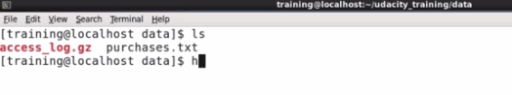
Hadoop Distributed File System
Demo

Slide 37
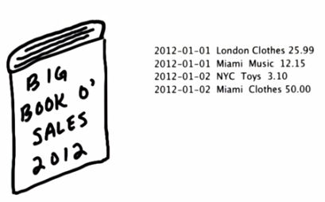

MapReduce Concept - 1
Problem with traditional way:
Long time
Run out of Memory

Slide 38
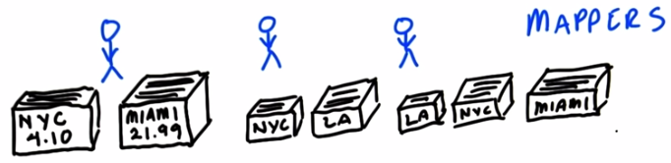
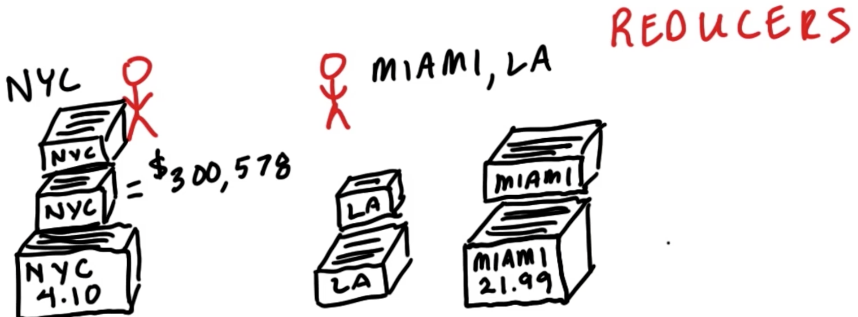
MapReduce Concept - 2

Slide 39
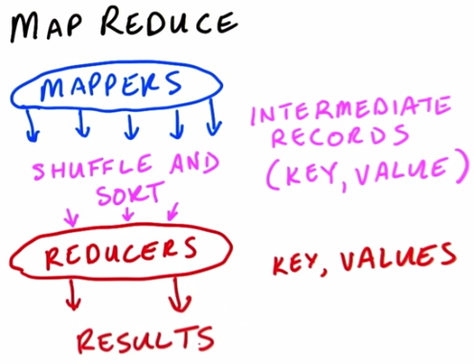
MapReduce Concept - 3
The Mappers are programs which
each deal with a relatively small amount of data,
they all work in parallel
The Mappers output what we call ‘intermediate records’, which in this case were our index cards
Hadoop deals with all data in the form of records, and records are key-value pairs
Once the Mappers have finished, a phase of MapReduce called the ‘Shuffle and Sort’ takes place
Reduce phase works on one set of records
one pile of cards -- at a time;
it gets the key, and then a list of all the values
it processes those values in some way
then it writes out its final data for that key.

Slide 40
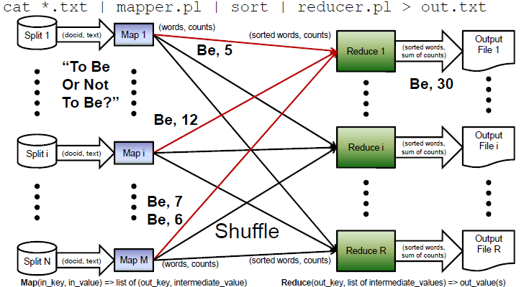
MapReduce: Computational Framework

Slide 41
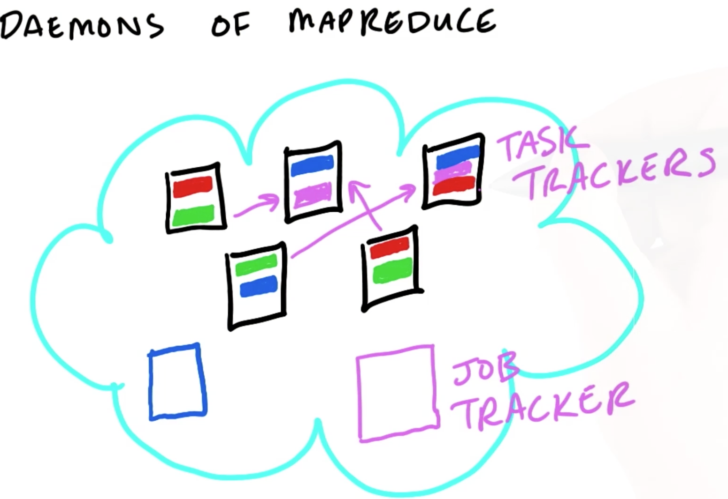
Map Reduce - Trackers

Slide 42
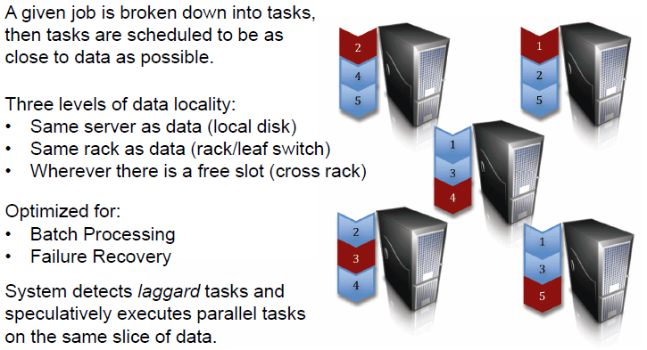
MapReduce: Resource Manager/Scheduler

Slide 43
MapReduce
Demo
Notes:
Hadoop is very verbose
Test data are small and Hadoop might not scale …
Output dir shouldn’t exists

Slide 44
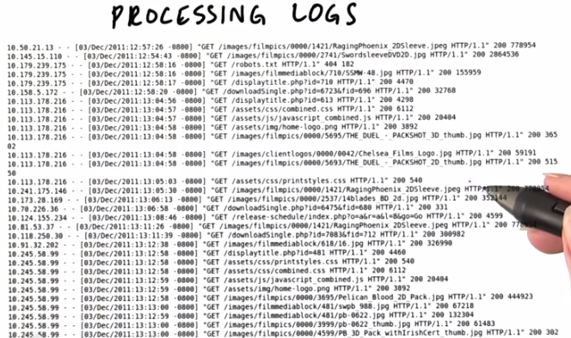
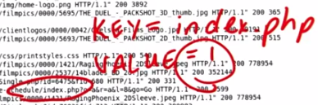
MapReduce - Example
Number of hits per page or top hit pages?

Slide 45
But Network Are Faster Than Disks!
Yes, however, core and disk density per server are going up very quickly:
Hard Disk = 100MB/sec (~1Gbps)
Server = 12 Hard Disks = 1.2GB/sec (~12Gbps)
Rack = 20 Servers = 24GB/sec (~240Gbps)
Avg. Cluster = 6 Racks = 144GB/sec (~1.4Tbps)
Large Cluster = 200 Racks = 4.8TB/sec (~48Tbps)
Scanning 4.8TB at 100MB/sec takes 13 hours.

Slide 46
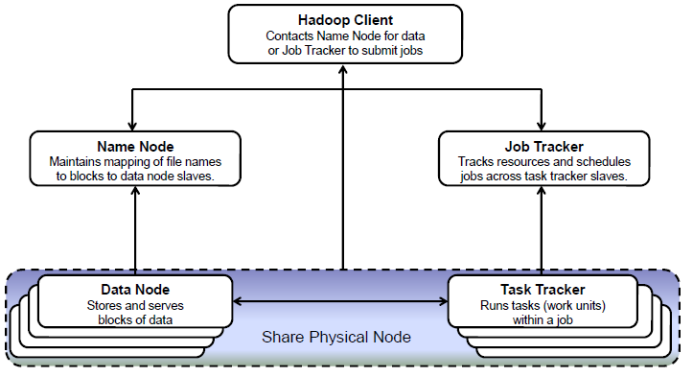
Hadoop High Level Architecture – Component Relationship

Slide 47
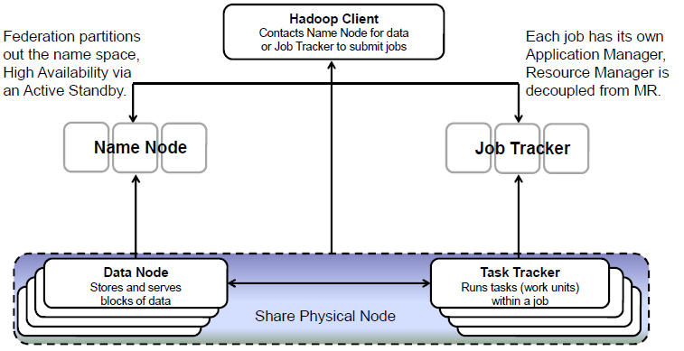
Changes For Better Availability/Scalability

Slide 48
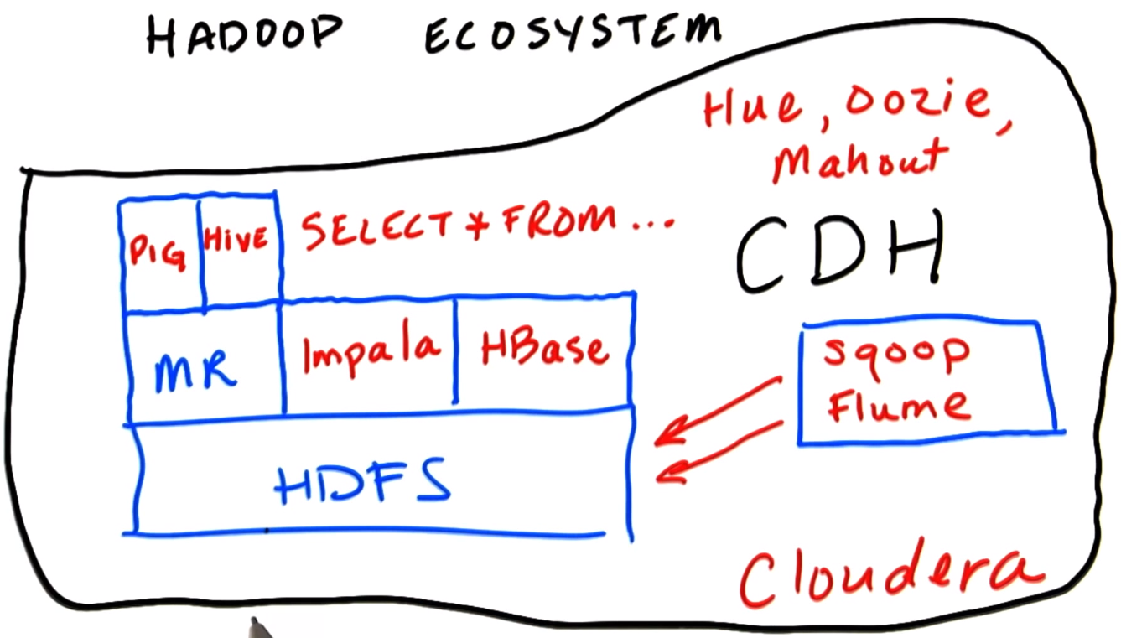
Hadoop Ecosystem
Notes:
Hive -> Hive interpreter translates the SQL into MapReduce code
PIG - > Analyze the data using simple scripting language by converting it into MapReduce
But it takes significant time for large amount of data to convert
IMPALA - > The SQL directly access the HDFS rather needing MapReduce. Also optimize for low latency query.
HIVE is optimize for long batch process
Scoop - > Takes data from other RDMS (e.g. SQL Server and put it in HDFS as tab delimited text file)
Flume -> Ingest the data as it is generated by the external system and put it in the Cluster
Hbase -> A real time database on top of HDFS
Hue -> Graphical frontend to the cluster
OOZIE -> Workflow management and Scheduling tool
MAHOUT -> Machine Learning Library

Slide 49
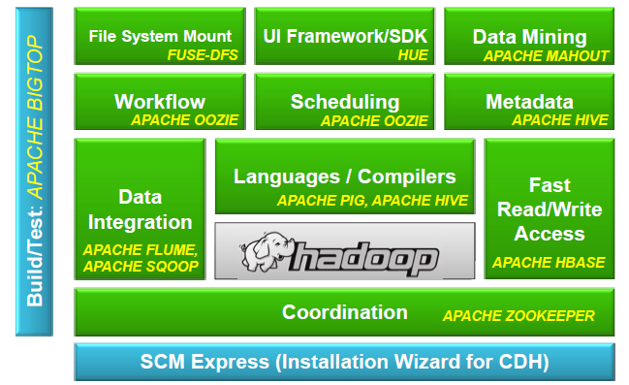
Cloudera’s Distribution Including Apache Hadoop
Notes:
Hive -> Hive interpreter translates the SQL into MapReduce code
PIG - > Analyze the data using simple scripting language by converting it into MapReduce
But it takes significant time for large amount of data to convert
IMPALA - > The SQL directly access the HDFS rather needing MapReduce. Also optimize for low latency query.
HIVE is optimize for long batch process
Scoop - > Takes data from other RDMS (e.g. SQL Server and put it in HDFS as tab delimited text file)
Flume -> Ingest the data as it is generated by the external system and put it in the Cluster
Hbase -> A real time database on top of HDFS
Hue -> Graphical frontend to the cluster
OOZIE -> Workflow management and Scheduling tool
MAHOUT -> Machine Learning Library

Slide 50
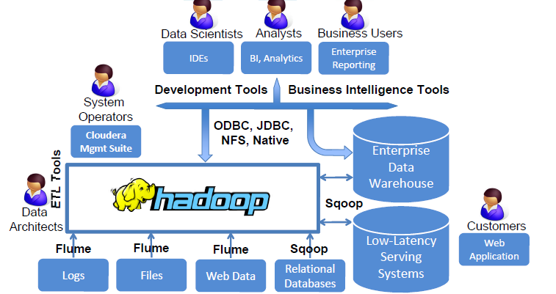
Hadoop In The Typical Enterprise Data Stack

Slide 51
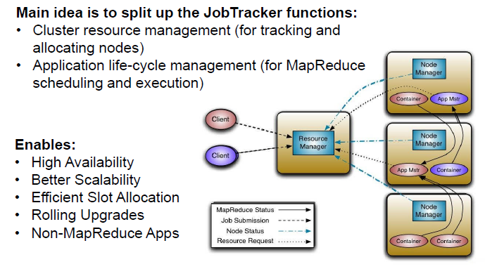
MapReduce – Next Generation

Slide 52
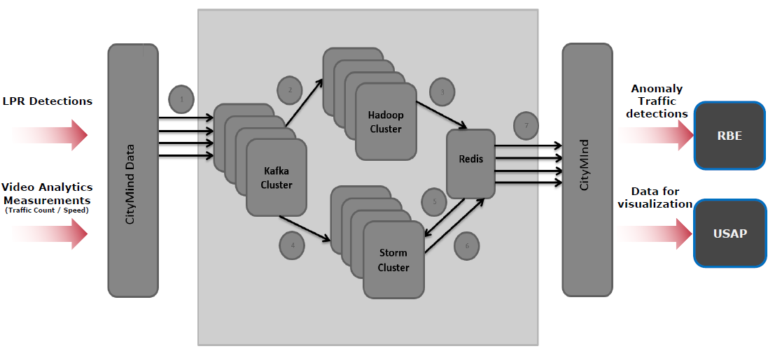
Example
Current USH Big-Data Architecture (LH project)

Slide 53
Conclusion:
The Key Benefits of Apache Hadoop:
Agility/Flexibility (Quickest Time to Insight).
Complex Data Processing (Any Language, Any Problem).
Scalability of Storage/Compute (Freedom to Grow).
Economical Storage (Keep All Your Data Alive Forever).
The Key Systems for Apache Hadoop are:
Hadoop Distributed File System: self-healing high bandwidth clustered storage.
MapReduce: distributed fault-tolerant resource management coupled with scalable data processing.

Slide 54
Thank You

Slide 55
BONUS

Slide 56
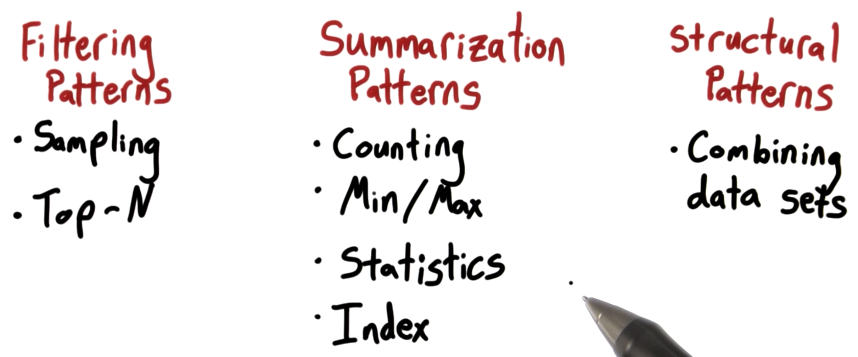
Design with Patterns

Slide 57
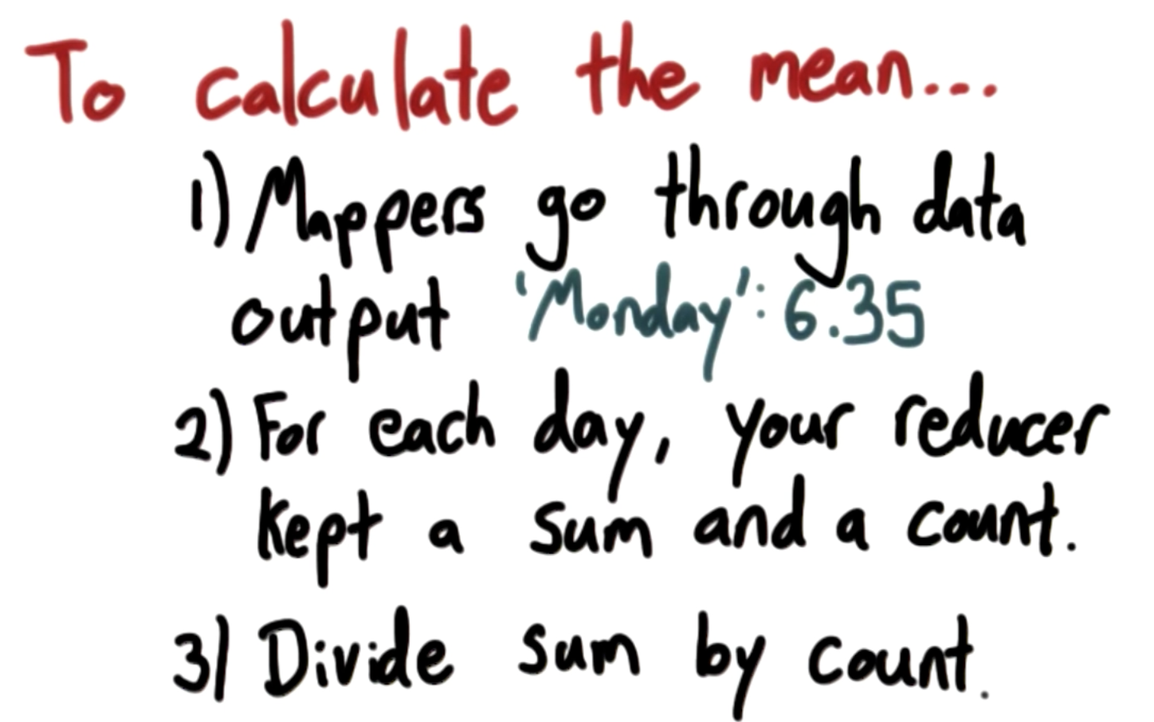
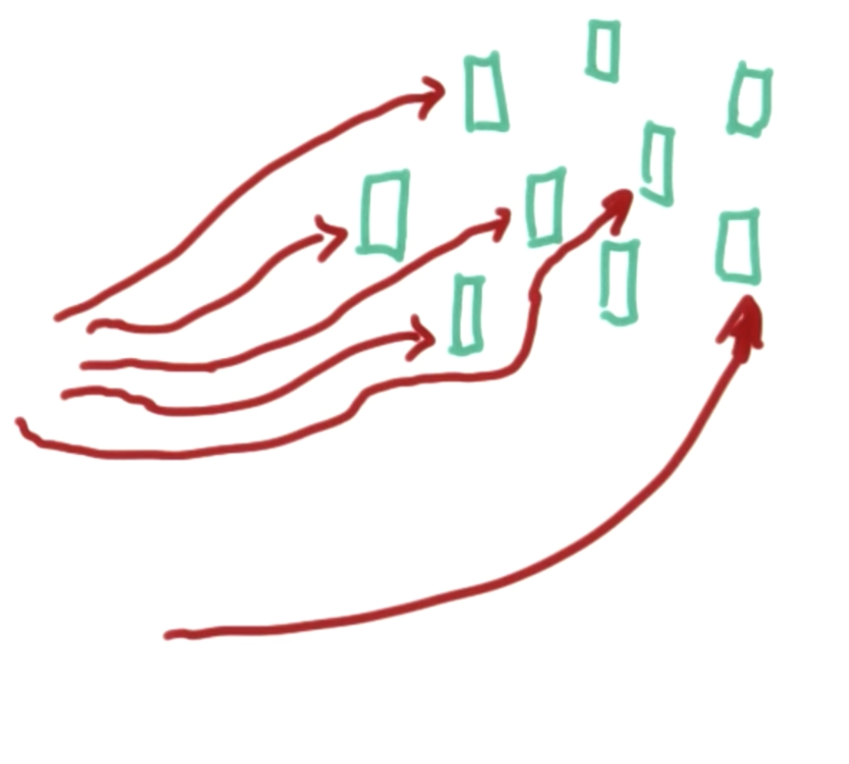
Combiners

Slide 58
Problem - 1
Write a mapreduce program that processes the purchases.txt file and output sum of sales for each weekday.

Slide 59
Problem - 2
We are interested seeing what are the top tags used in posts.
Write a mapreduce program that would output Top 10 tags, ordered by the number of questions they appear in.
For an extra challenge you can think how to get a top 10 list of tags, where they are ordered by some weighted score by your choice.

Slide 60
Problem - 3
We have a lot of passionate students that bring a lot of value to forums. Forums also sometimes need a watchful eye on them, to make sure that posts are tagged in a way that helps to find them, that the tone on forums stays positive, and in general - they need people who can perform some management tasks - forum moderators. These are usually chosen from students who already have shown that they are active and helpful forum participants.
Our students come from all around the world, so we need to know both at what times of day the activity is the highest, and to know which of the students are active at that time.
In this exercise your task is to find for each student what is the hour during which the student has posted the most posts. Output from reducers should be: author_id hour

